Slide 1

The Urgent Need
for Better Cyberhealth
for Small Organizations
September 21, 2022

Slide 2
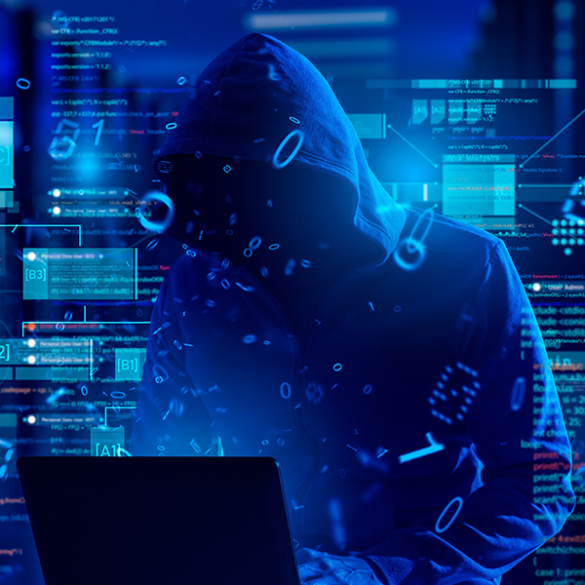
Huge, Underserved Market with Fast Growing Need
There are 6 million Small and Medium- sized Organizations (SMOs) in the U.S.
43% of cybersecurity attacks target small businesses.
424% increase in new small business cybersecurity breaches last year.
47% of small businesses say they have no understanding of how to protect themselves.
The Future:
Cybersecurity Attacks are only going to grow in number and sophistication.

Slide 3
If Your Organization Doesn’t Understand These Terms
Vulnerability
Wi-Fi
MFA
Backdoor
Social Engineering
VPN
Penetration Testing
Patches
Firewall
Critical Infrastructure
PII
Breach
Cloud
Clickjacking
Endpoint
IP Address
Botnet
Spear Phishing
DDoS
SensCy
Ransomware
Authenticator
Deepfake
Spyware
Backup
Rootkit
Worm
Dark Web
Virus
Password
BYOD
Solar Winds
Open Source
Remote Access
Malware
Credential Harvesting
Exploit
Keylogger
Disaster Recovery
Log4j
Black Hat
Encryption
Trojan Horse
You Are in Cyber Trouble and Need Help!

Slide 4
These are Things to Worry About!
Vulnerability
Backdoor
Social Engineering
Penetration Testing
Breach
Clickjacking
Botnet
Spear Phishing
DDoS
Ransomware
Deepfake
Spyware
Rootkit
Worm
Dark Web
Virus
Solar Winds
Malware
Credential Harvesting
Exploit
Keylogger
Log4j
Black Hat
Trojan Horse

Slide 5
These are Tools to Have or Actions to Take!
Wi-Fi
MFA
VPN
Patches
Firewall
Critical Infrastructure
PII
Cloud
Endpoint
IP Address
Authenticator
Backup
Password
BYOD
Open Source
Remote Access
Disaster Recovery
Encryption

Slide 6
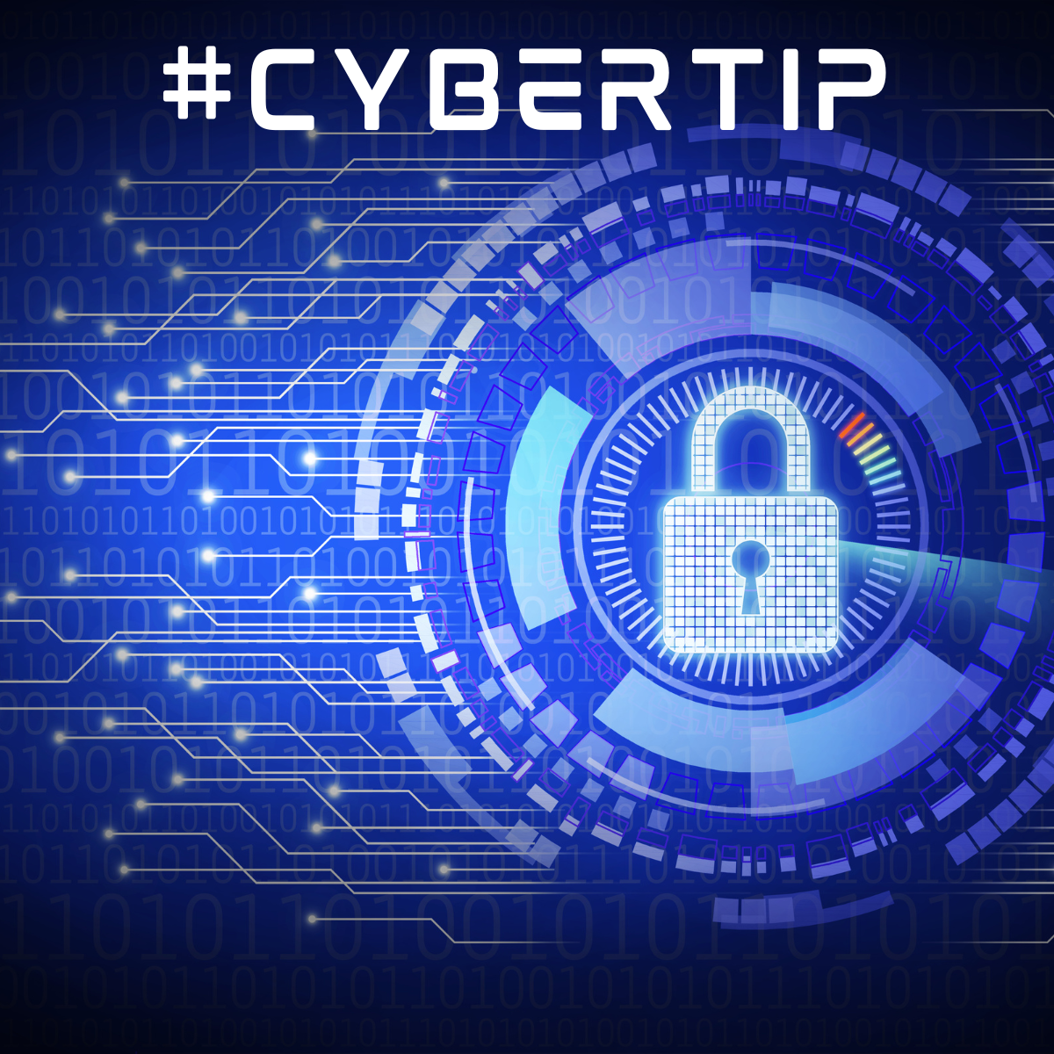

Common Successful Attacks
A phishing email involving
  paycheck issues
  the supply chain
  a request for personal information
A bad guy finding someone:
  who didn’t update their software
  who didn’t follow proper password practices
  on an open public network

Slide 7
The Picture Facing Most Small Organizations
Running a successful organization is a full-time effort without cybersecurity concerns
Cyber is confusing – Is this stuff from Mars? No time to understand
Internal or external IT staff are often fully occupied with traditional IT
An SMO cannot find or afford dedicated internal cyber staff
External parties are generally trying to sell some cyber solution
Getting cyber insurance is confusing and expensive
What to Do?

Slide 8
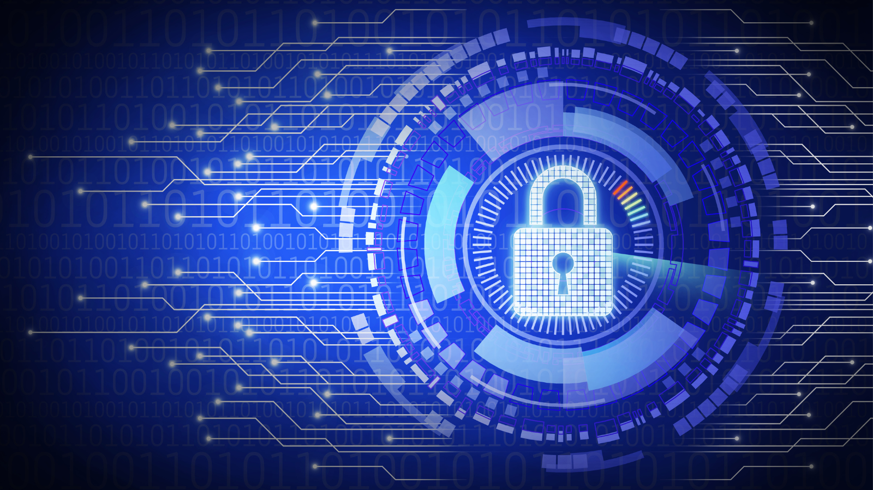
Our Philosophy
88% of cyberattacks can be avoided with proper cyber hygiene
SMOs need understandable, easy-to-use solutions in plain language
Cybersecurity requires a holistic approach – identify, protect, detect, respond, recover
Personal touch (people) + visibility into cyberhealth (technology) = an active cybersecurity culture
An active cybersecurity culture is:
  Better protected from cyber incidents
  Better prepared to respond to incidents
  Can recover and stay in business

Slide 9
Best Practices to Adopt
Password policy
Multi-factor authentication
Awareness Training
Phishing defense
Wi-Fi security
Virtual private network
User access control
Physical controls
Endpoint protection
Firewall configuration
Software update
Monitoring alert feeds
Data back up
Incident Response Plan

Slide 10
SensCy – Sensible Cyber is the Answer
Trusted guide in cyber – our only business is helping SMOs improve their cyber health
Experienced team that understands and stays on top of the cyber world
Help SMOs:
  Implement a prioritized cyber plan with ongoing metrics of success including an overall cyberhealth score
  Avoid having a successful cyberattack
  Take measures to recovery quickly if successfully attacked
  Understand cyber in plain language and measures cyber health on an ongoing basis
  Find the best cyber vendors and best cyber insurance policies
We are a strong cyber partner for an affordable monthly subscription

Slide 11









SensCy’s Hybrid Solution – People and Technology
INCIDENT RESPONSE & EXECUTIVE BRIEFING
Crisis management & ongoing briefings to your leadership team, key stakeholders or board members
DASHBOARD & CLIENT CHECK-IN
Visibility into your cyberhealth & regular touchpoints to ensure your cyberhealth plan is on track
CYBERHEALTH PLAN
A client customized plan to improve your cyberhealth score
TRAINING
Awareness, policy & phishing training help your employees become a first line of defense
INITIAL & PERIODIC
INITIAL & PERIODIC
INITIAL & PERIODIC
BI-MONTHLY
PERSISTENT
PERSISTENT & WEEKLY
AS NEEDED
INITIAL & ANNUAL
ANNUAL
CYBERHEALTH CHECK
Generates your cyberhealth score – like a credit score for your cyberhealth
EXTERNAL SCANS
Vulnerability and dark web scanning help keep you protected
ALERTS
Proactive outreach for emerging threats – tailored to your systems
INSURANCE ASSISTANCE
The help you need to obtain cybersecurity Insurance
CYBER POLICY
A policy library to ensure you are following best practices
Notes:
Dave: What’s required of client in order to hit this 5-week timeline.

Slide 12

Summary: Small Organizations Need Help!
Cybersecurity is the #1 overall risk in the business world
Cybersecurity threats are continually growing with no end in sight
The vast SMO market of 6 million is significantly underserved
Proper cybersecurity protection requires an active cyberhealth culture
A hybrid solution for SMOs is key. Technology-only solutions are inadequate. People using plain language are needed.
Utilize a trusted party watching over cybersecurity on a full-time basis

Slide 13

The Trusted Guide to Sensible Cyber
for Small and Medium-Sized Organizations

